Slide 1
What is the Importance of Clustering?

Slide 2
What is Clustering?
Classify each data point into a specific group.
Data points that are in the same group should exhibit similar features, while data points in different groups exhibit dissimilar properties and features.
Unsupervised learning and is a common technique for statistical data analysis used in many fields.

Slide 3
Types of Clustering
Hard Clustering
Each data point either belongs to a Cluster completely or not.
This means that every data point will belong to one and only one cluster at a time.
Soft Clustering
Each data point can belong to Multiple Clusters at the same time.
This Means data points can be associated to Multiple Clusters at the same time.

Slide 4
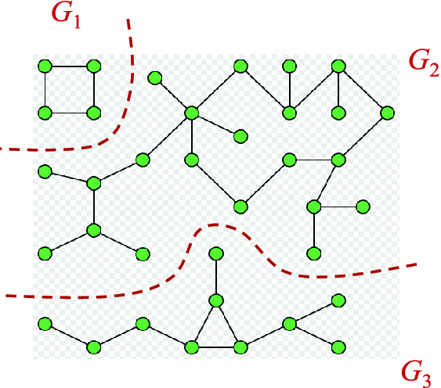
Connectivity Based Clustering
These Models work on the basis of Distance and assume that if the two data points are closer to each other they are similar to each Other.
The data points lying closer to each other will be grouped together in one Cluster, and the data points lying far from each other will be separated in different clusters.

Slide 5
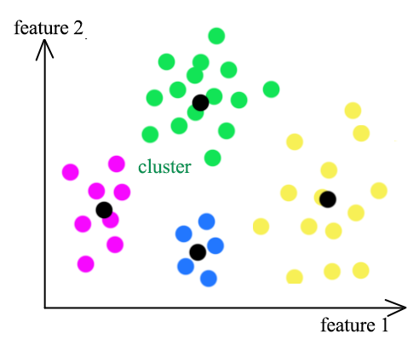
Centroid Based Clustering
These Models work on the notion that similarity is derived by the closeness of a data point to the centroid of the clusters.
The Points will be divided into different Clusters based on the Closeness to a Centroid.
One of the Most Famous algorithms that fall under this category is K Means Algorithm.

Slide 6
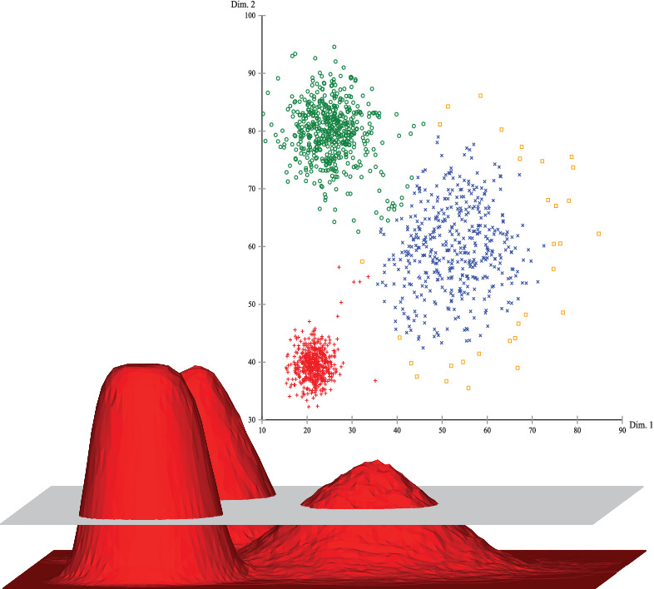
Density Based Clustering
These Models cluster the data points by finding areas of Varied density, and assigning data points to these different density regions.
One of the Most Famous Algorithms that fall under this category is DBSCAN.

Slide 7
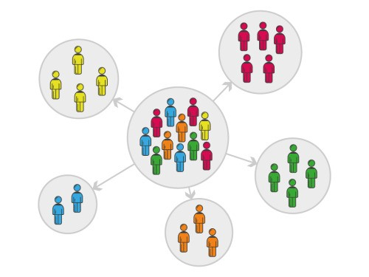
Popular Applications of Clustering
In the Field of Sales and Marketing
Optimization of Marketings Ad Campaigns for Best Returns.
Tracking Down Target Customers for better Revenue Generation.
Grouping Customer with Similar Characteristics to Increase Sales.

Slide 8
Some More Applications
Fake News Detection by clustering the Fake News together.
Spam Mails Filtering by clustering the Spam Mails together.
Finding Distinct Groups for Email Marketing and Follow Ups.
Finding Distinct Groups for Providing Offers and Benefits to Customers.
Finding Distinct Groups for Making Coaching Groups for Students and many

Slide 9
Using Elbow Method
for Choosing
Best Value for K

Slide 10
Elbow Method
The elbow method is a heuristic used in determining the number of optimum clusters in a data set.
This Method Helps us to find out the Optimum Number of Clusters in a Data set.
We plot the explained variation against the number of clusters and finally pick the elbow of the curve as the number of clusters to use.

Slide 11
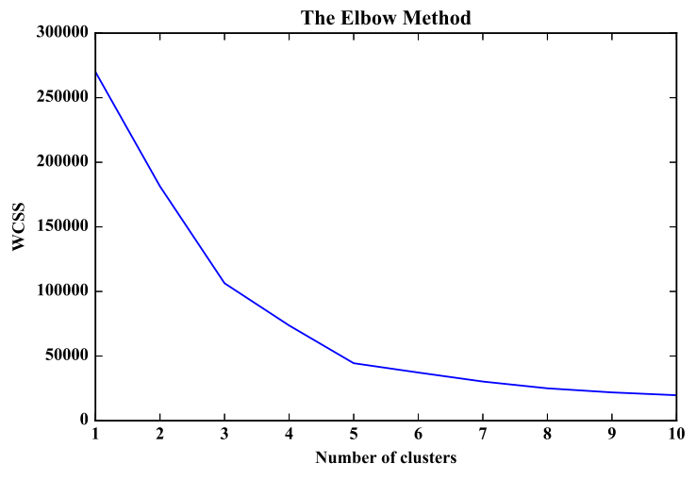
First
Elbow
Second Elbow
Always Consider the Last Elbow

Slide 12
Introduction to K Means Clustering

Slide 13
K Means Clustering
K Means algorithm is a Centroid Based Algorithm.
It tries to make the intra-cluster data points as similar as possible while also keeping the clusters as different as possible.
It assigns data points to a cluster such that the sum of the squared distance between the data points and the cluster’s centroid minimum.
The less variation we have within clusters, the more homogeneous the data points are within the same cluster.

Slide 14
Using Silhouette Score to analyze the clusters

Slide 15
Silhouette Values
Silhouette values lie in the range of -1 and 1. The Value of +1 is ideal and -1 is least preferred.
Value of +1 indicates that the sample is far away from its neighbouring cluster and very close to the cluster it is assigned.
Value of -1 indicates that the point is close to its neighbouring cluster than to the cluster its assigned.
Value of 0 means it's at the boundary of the distance between the two clusters.

Slide 16
Working of Silhouette Analysis
It measures the quality of a clustering. That is, it determines how well each object lies within its cluster.
The optimal number of clusters k is the one that maximizes the average silhouette over a range of possible values for k.

Slide 17
Introduction to Hierarchical Clustering

Slide 18
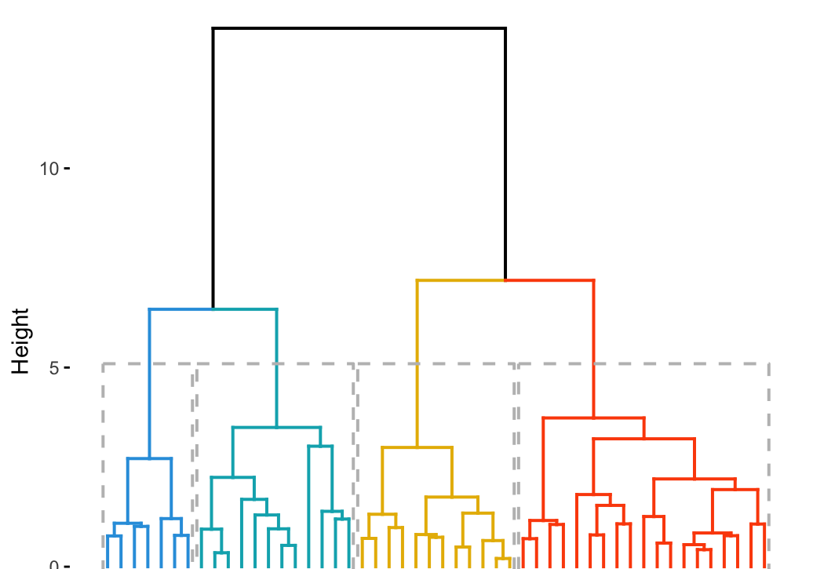
Hierarchical Clustering
An algorithm that groups similar objects into groups called clusters.
The endpoint is a set of clusters, where each cluster is distinct from each other cluster.

Slide 19
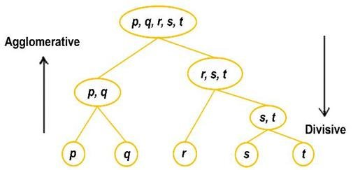
Types of Hierarchical Clustering
There are two types of hierarchical clustering
Divisive
Agglomerative

Slide 20
Divisive Method
Top-down clustering method
Assign all of the observations to a single cluster and then partition the cluster to two least similar clusters.
Proceed recursively on each cluster until there is one cluster for each observation.
Produce more accurate hierarchies than agglomerative algorithms in some circumstances but are conceptually more complex.

Slide 21
Agglomerative Method
Bottom-up clustering method
Assign each observation to its own cluster.
Compute the similarity (e.g., distance) between each of the clusters and join the two most similar clusters.
It repeats until there is only a single cluster left.

Slide 22
Methods for Computing Distance
There are three different methods which differ in how the distance between each cluster is measured.
Single Linkage.
Complete Linkage
Average Linkage

Slide 23
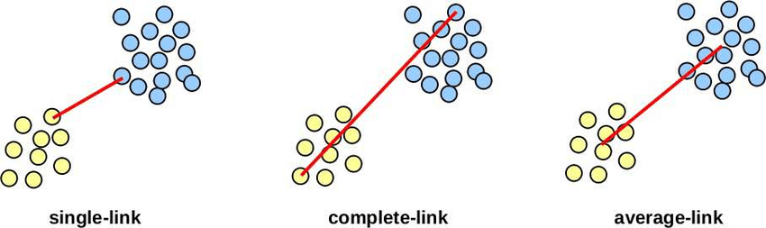
Single Linkage
Distance between two clusters is defined as the shortest distance between two points in each cluster.
For example : the distance between clusters “r” and “s” to the left is equal to the length of the arrow between their two closest points.

Slide 24
Complete Linkage
Distance between two clusters is defined as the longest distance between two points in each cluster.
For example, the distance between clusters “r” and “s” to the left is equal to the length of the arrow between their two furthest points.

Slide 25
Average Linkage
Distance between two clusters is defined as the average distance between each point in one cluster to every point in the other cluster.
For example, the distance between clusters “r” and “s” to the left is equal to the average length of each arrow connecting the points of one cluster to the other.

Slide 26
Introduction to DBSCAN Clustering

Slide 27
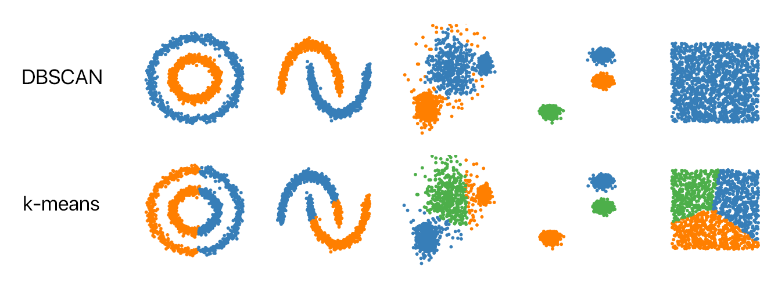
DBSCAN Clustering
DBSCAN groups together points that are close to each other based on a distance measurement and a minimum number of points.
It also marks the outliers which lie in low-density regions.

Slide 28
DBSCAN Model Parameters
The DBSCAN algorithm basically requires 2 parameters which are
Eps: Specifies how close points should be to each other to be considered a part of a cluster.
This Value will be considered as a threshold for considering two points as a Neighbor.
MinPoints: is the minimum number of points to form a dense region.
Generally, the Number of MinPoints is Equal to Twice the Number of Columns in the Dataset.

Slide 29
Types of Points in a DBSCAN Cluster
There are three types of points after the DBSCAN clustering is complete:
Core: It is a point that has at least m points within distance n from itself.
Border: This is a point that has at least one Core point at a distance n.
Noise: which is a point that is neither a Core nor a Border. And it has less than m points within distance n from itself.

Slide 30
DBSCAN Algorithm
Step 1: Find all the neighbor points within eps and identify the core points or visited with more than MinPts neighbors.
Step 2: For each core point if it is not assigned to a cluster, create a new cluster.
Step 3: Find recursively all its density connected points and assign them to the same cluster as the core point.
Step 4: Iterate through the remaining unvisited points in the dataset. Those points that do not belong to any cluster are noise.

